Slide 1

A hot ticket Project
Content Note
The FIFA Women’s World Cup is a world championship tournament for women’s soccer. It is held every four years in different countries.
The Hong Kong Sevens Rugby is a three-day rugby tournament that is one of the most popular competitive team sporting events in South East Asia. Fans travel from all over the world to watch 28 rugby teams compete.
Run for Your Lives was a series of 5k runs with a zombie theme that took place in the United States. Race staff would dress as zombies and chase runners in the fast and entertaining races. The races were held from 2011 to 2013.
The Dubai World Cup is a horse race that takes place every year in March at the Meydan Racecourse in Dubai. Race day is known as one of luxury and riches, with prizes totaling US $ 10 million. The winner gets US $ 6 million.
The Tour de France is an annual cycling race that travels through the countryside of France. The three-week-long race, which usually takes place in July, has been held since 1903. The course changes each year.
Wimbledon is a championship tennis tournament held in England each summer. It has been held since 1877, making it the oldest tennis tournament in the world. Fans travel from all over and pay high ticket prices to watch the world’s best ranked tennis players compete.
A. Choose a sporting event. Work with a partner. Choose one of the events in the box or think of your own idea.
FIFA Women’s World Cup
Hong Kong Sevens Rugby
Run for Your Lives
The Dubai World Cup
The Tour de France
The Wimbledon Championships
Another idea:_____________

Slide 2
A hot ticket Project
B. Research your event. Answer these questions.
What is the name of your event? What kind of event is it?
Where and when is it?
What happens, and why is the event interesting?
C. Make tickets. Use your answers to the questions in B to make tickets for your event. Make eight tickets for your event.
D. Present your event. Work with other pairs. Explain your event. Use your answers from B. Change roles and learn about other events.
E. Get tickets. With your partner, choose one event to go to together. The tickets are free (they don’t cost any money) but you must get them quickly. Which event is the most popular? Do you give away all your tickets?

Slide 3
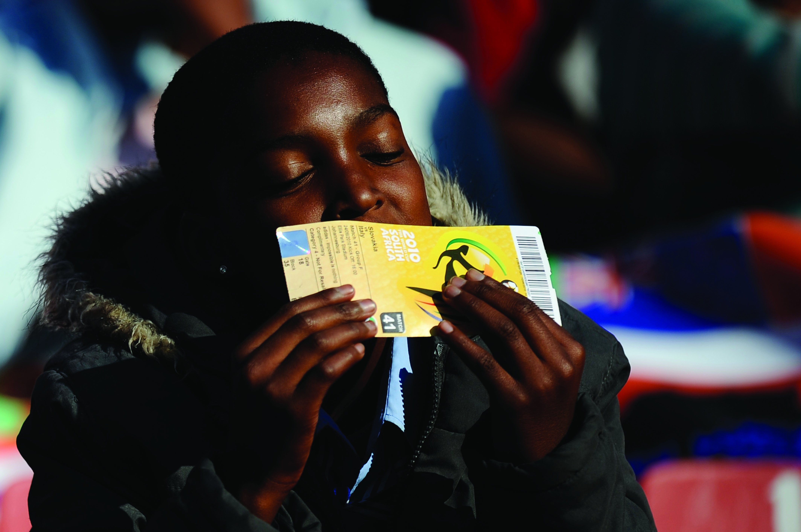
A hot ticket Project
Make a poster. Make a poster for the sports event you talked about in the Expansion Activity. Use photos from the Internet. Show your poster to your friends to get their comments. Then, when you are finished, show the final poster to your class.
A South African woman kisses her tickets to a World Cup soccer match.

